Slide 1
13
Events
Session 11
(slot 20-21)

Slide 2
Objectives
Explain Events and Event Handler.
Do exercises

Slide 3
Event
An event occurs when the user interacts with the web page. Some of the commonly generated events are mouse clicks, key strokes, and so on.
The process of handling these events is known as event handling. Event handling is process of specifying actions to be performed when an event occurs. This is done by using an event handler.
The event handler is a scripting code or a function that defines the actions to be performed when the event triggered.
When an event occurs, an event handler function that is associated with the specific event is invoked.

Slide 4
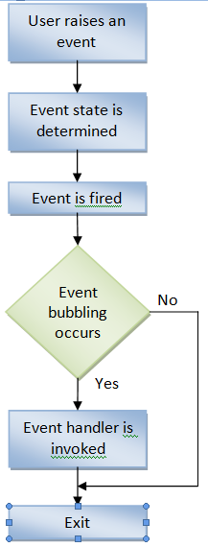
Event Bubbling
Event bubbling is a mechanism that allows you to specify a common event handler for all child elements. This means that the parent element handles all events generated by the child elements.
Life circle of an event:
  The user performs an action to raise an event.
  The event object is updated to determine the event state.
  The event is fired.
  The event bubbling occurs as the event bubbles through the elements of the hierarchy.
  The event handler is invoked that performs the specified actions.

Slide 5
Keyboard Event
Keyboard events are the events that occur when a key or a combination of keys are pressed or released from a keyboard. Theses events occur for all keys of keyboard.
Some keyboard events:
  onKeyDown: Occurs when a key is pressed down.
  onKeyUp: Occurs when a key is released.
  onKeyPress: Occurs when a key is pressed and released.
Notes:
onKeyDown: nhấn xuống nhưng chưa nhả ra
onKeyUp: nhấn xuống nhưng phải nhả ra
onKeyPress: nhấn và nhả ra

Slide 6
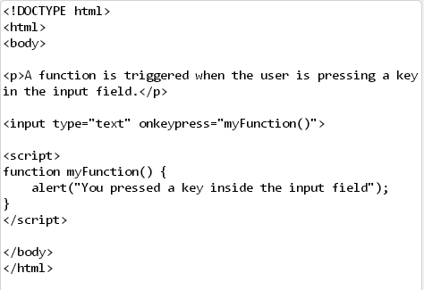
keyboard event - Demo

Slide 7
Mouse Event
Mouse events are the events that occur when the user uses mouse on the elements.
Some mouse events:
  onMouseDown: Occurs when the mouse button is pressed.
  onMousUp: Occurs when the mouse button is released.
  onMouseClick: Occurs when the mouse button is clicked.
  onDblClick: Occurs when the mouse button is double-clicked.
  onMouseMove: Occurs when the mouse pointer is moved from one location to other.
  onMouseOver: Occurs when the mouse pointer is moved over element.
  onMouseOut: Occurs when the mouse pointer is moved out of the element.

Slide 8
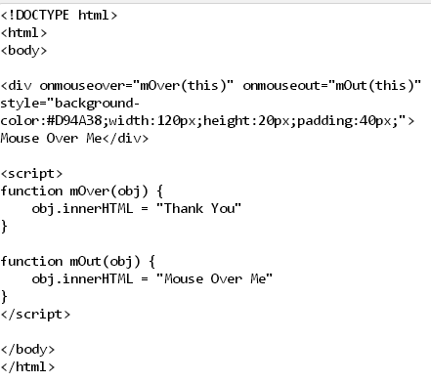
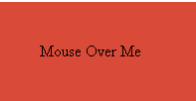
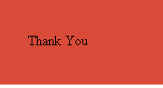
mouse event - Demo
Demo: S13_KeyboardEvent.html

Slide 9
Focus and selection Event
The focus events determine the activation of various elements that use the INPUT element. It allows you to set or reset focus for different INPUT elements.
The selection events occur when an element is selected.
Some events:
  onFocus: Occurs when an element receives focus.
  onBlur: Occurs when an element loses the focus.
  onSelectStart: Occurs when the selection of an element starts.
  onSelect: Occurs when the present selection changes.
  onDragStart: Occurs when the selected element is moved.
Notes:
onFocus: con trỏ màn hình
onBlur: khi con trỏ biến mất
onSelectStart:
onSelect:
onDragStart:

Slide 10
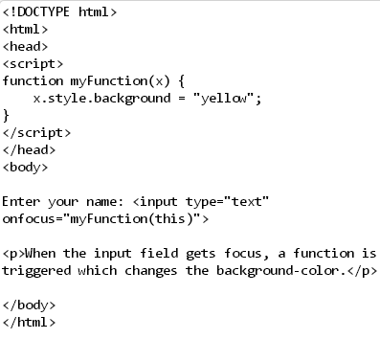


Focus event - Demo

Slide 11
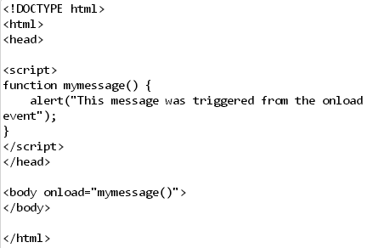
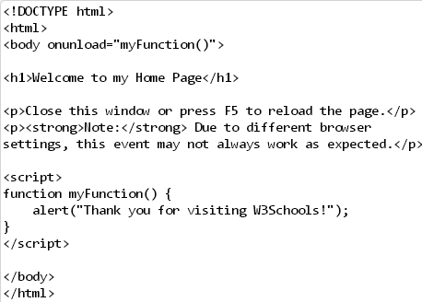
Onload/onunload event - Demo

Slide 12
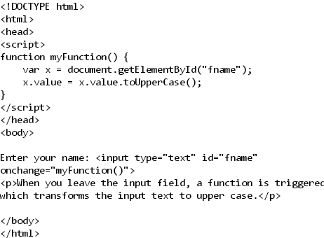


Onchange event - Demo

Slide 13
Summary
Event occur when the user interacts the web page
The process of handling these events is known event – handling.
Event – handling is a process of specifying actions to be performed when an event occurs.

Slide 14
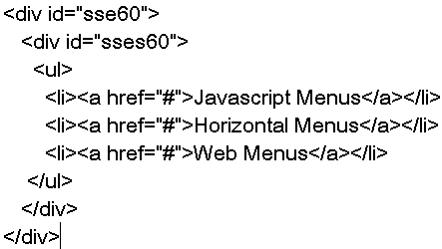
exercise
Html code

Slide 15
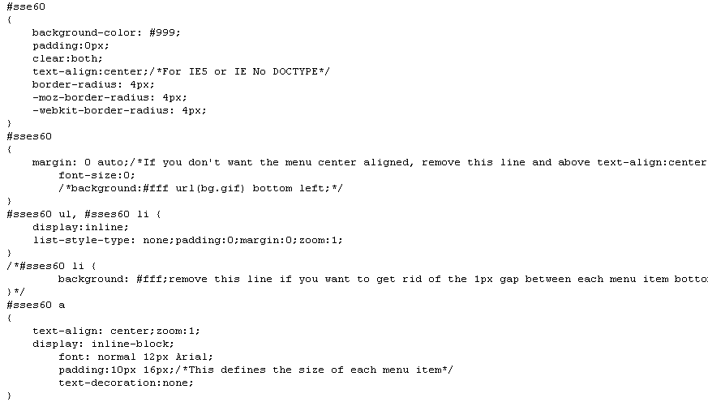
exercise
Css code

Slide 16
exercise
JavaScript code: review examples in session 9

